Slide 1
The Multithreaded Maniacs’ Trivia Maze
By Jesse Ross, Gabe Ries, Hunter Rich

Slide 2


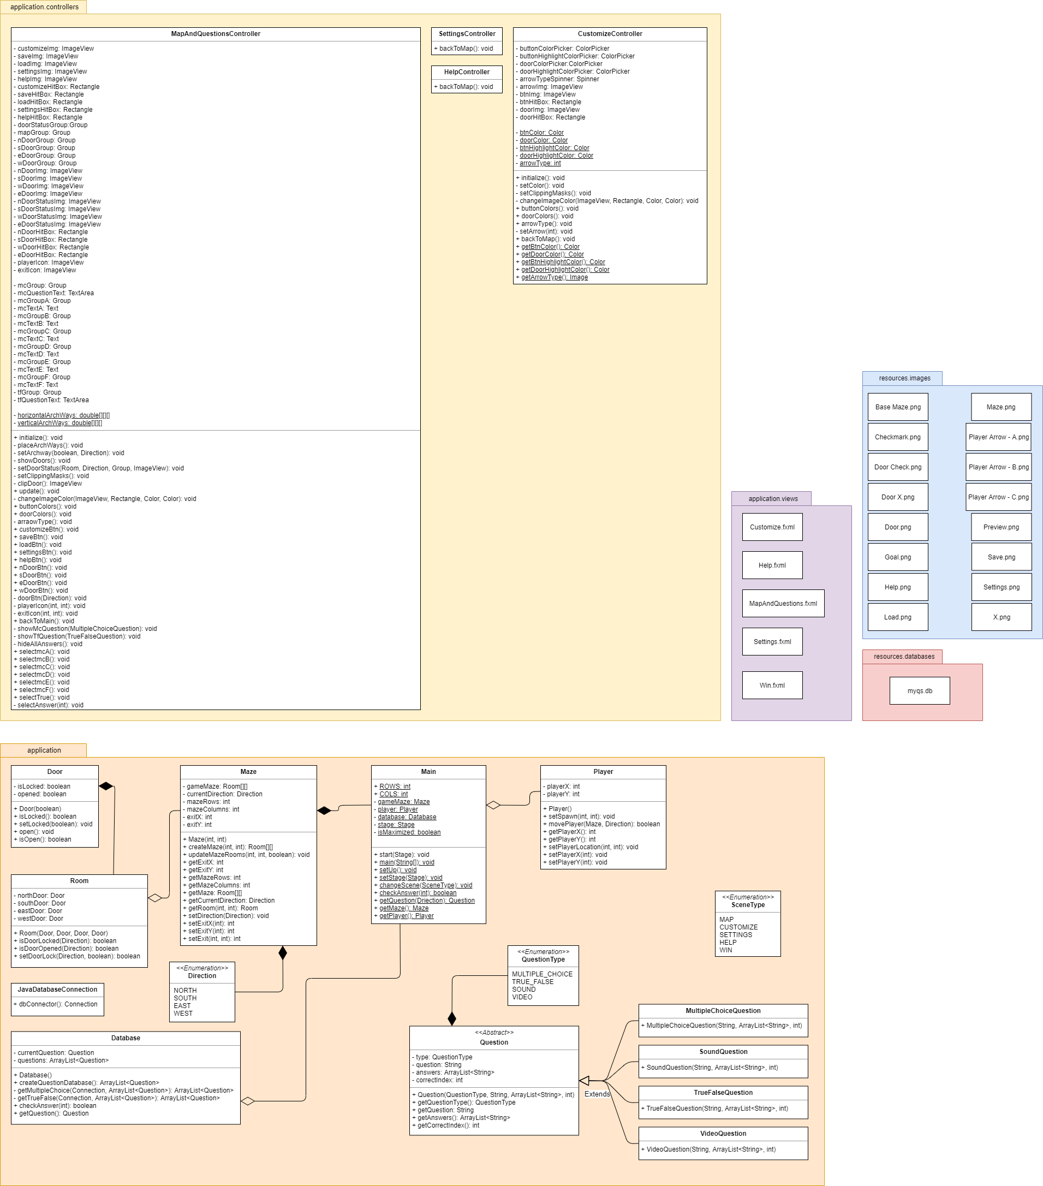

Current UML
z
Notes:
Not up to date

Slide 3
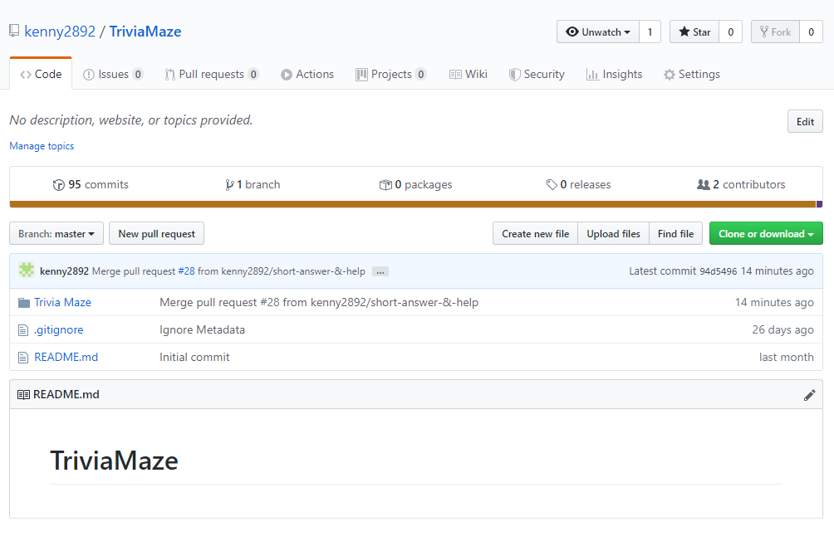
GitHub
Notes:
28 Pull Request and 95 Commits

Slide 4
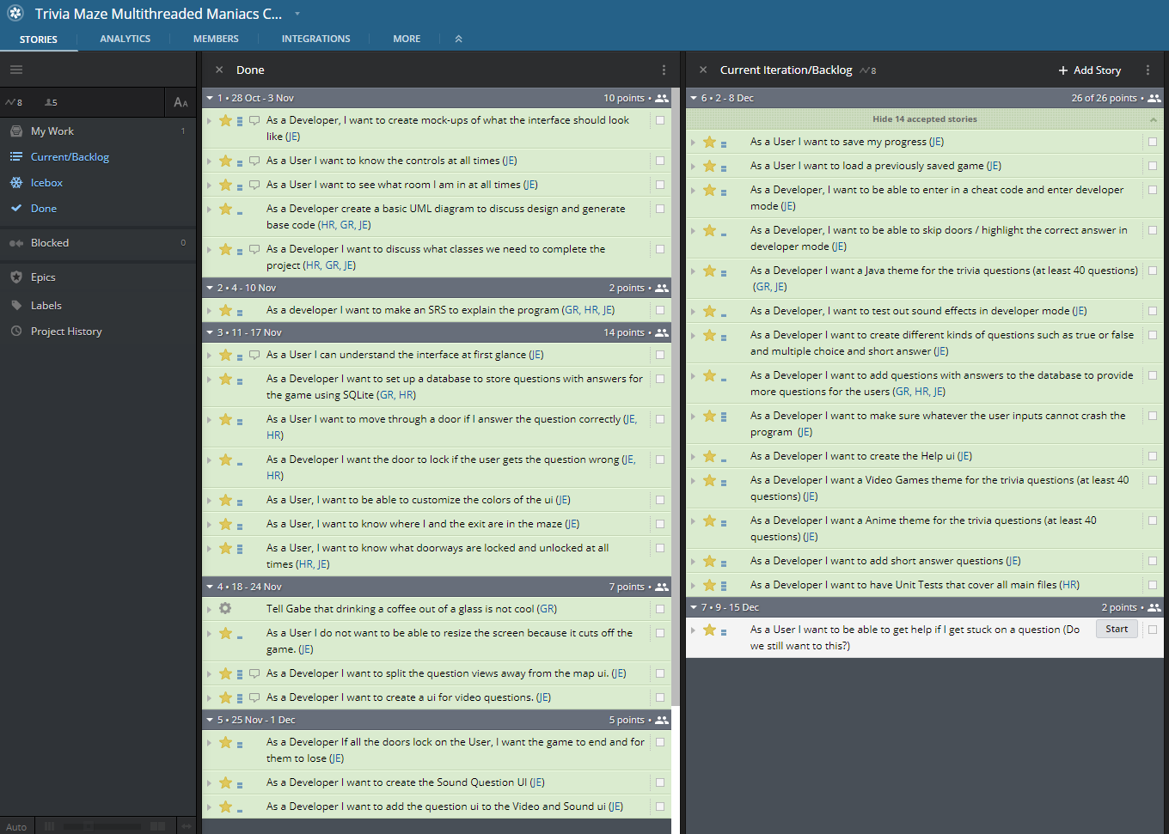
Pivotal Tracker

Slide 5
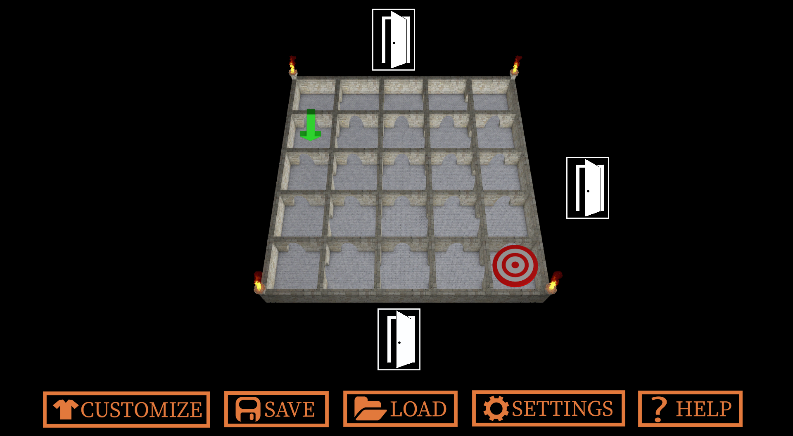
Demo

